Slide 1

Differentiated Instruction
A.T. is a third grade student at:
Thomas Jefferson Elementary School
By Beth Forti

Slide 2
Background information
Enjoys:
Reading
Gymnastics
Soccer
Reading level: Lowest reading level in her class.
Star results:
instructional level 2.5 (benchmarked)
BRI results:
independent reading level: second grade
instructional reading level: third grade
frustration reading level : fourth grade
Need to work on: low ratings from BRI on inferences, main ideas, reading rate, reading with expression, fluency, tending to punctuation and substitutions

Slide 3

My student does not have an IEP but was chosen because the results of the Star reading assessment classify her as “at risk.” I focused my tutoring strategies based on the results of the BRI.
The areas I will focus on during my tutoring lessons with A.T. will address:
Comprehension
Attending to punctuation
Making predictions and inferences
Finding the main ideas
Sequencing
Staying focused during reading

Slide 4

Strategies I incorporated into my tutoring lessons:
Tapping the table when there is a period or a comma.
Picture walks.
Making predictions before, during and after reading the text.
Reviewing vocabulary words before and after reading the text.
Story Maps.
Making connections to the text by writing about the text and applying it to her own life.
Introduced compound words and digraphs.

Slide 5

Which strategies worked:
Tapping the table to address punctuation worked well for this student.
Reviewing the vocabulary words with A.T. before reading the text was a great way to increase her comprehension of the text. We discussed the meanings of the words before reading the text and she felt more comfortable while reading the text. She stated that this really helped her, because she did not know what a lot of the words meant.
A.T. really enjoyed using the predict-o-gram before and after reading the text.
Discussing the title of the book and doing a picture walk were great strategies for this student. This strategy provided her with a reason to read.
A.T. was able to stay focused during our one-on-one tutoring sessions.

Slide 6

What we need to continue to work on:
A.T. does very well with one-on-one instruction, but she still continues to have a difficult time staying focused in the classroom. If I continued tutoring this student, I would include two other students into our lessons and gradually build up the number of students. I think this many help A.T. to learn how to stay focused during classroom activities.
I would continue having her make predictions throughout her reading.

Slide 7



Reflection:
My tutoring lessons with A.T. went very well. She was able to stay focused throughout the entire lesson.
Reviewing the vocabulary before reading the text helped with her comprehension.
Making predictions and inferences also increased her comprehension of the text.
She started making connections with the text and did not struggle writing her responses.
I thought the tutoring lessons were a great success and hopefully she benefited from our time together.

Slide 8
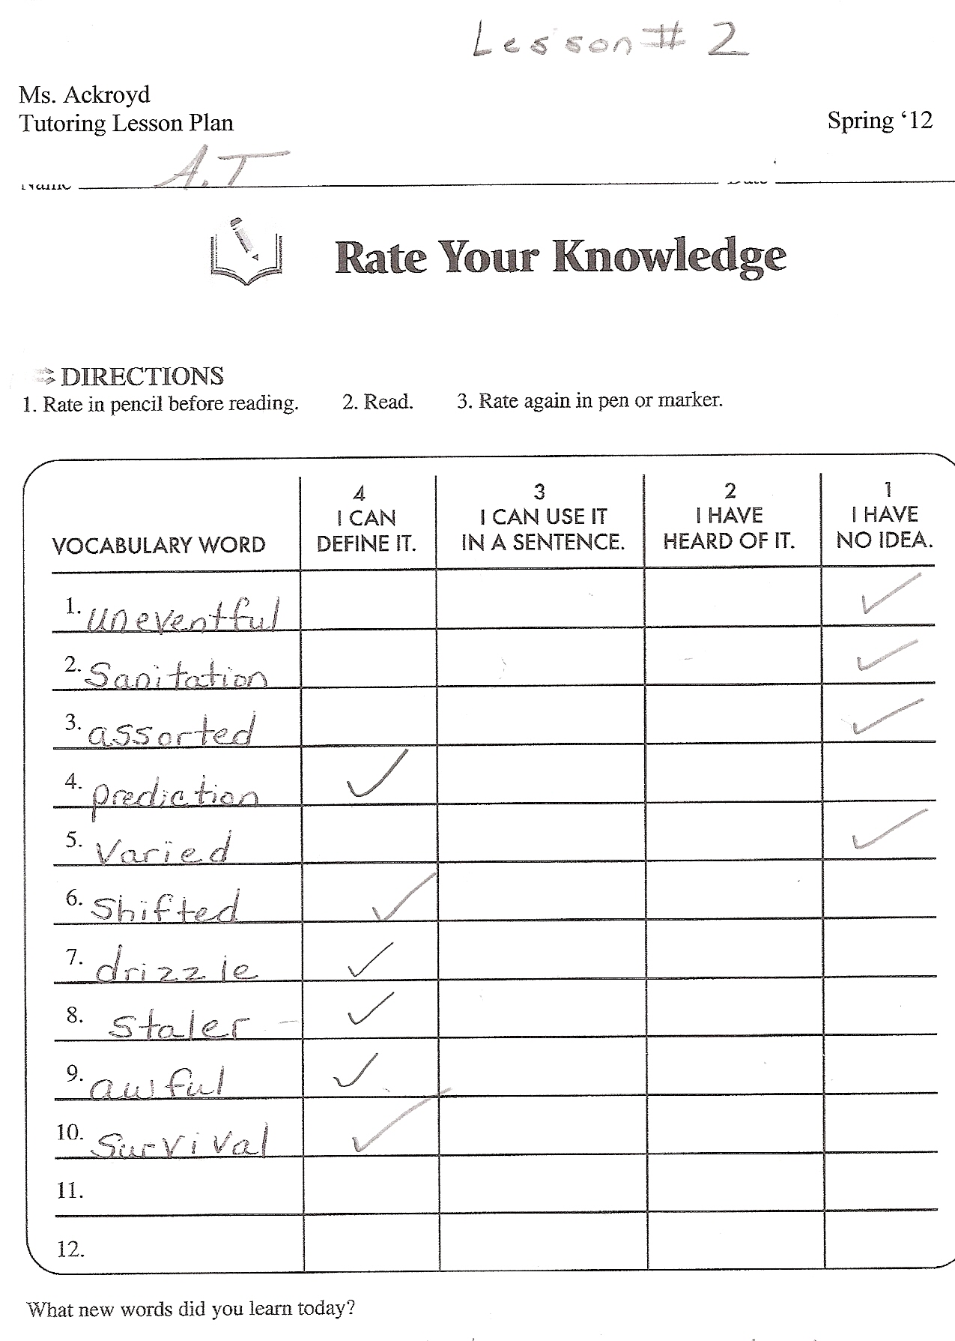
Samples of A.T.’s work

Slide 10
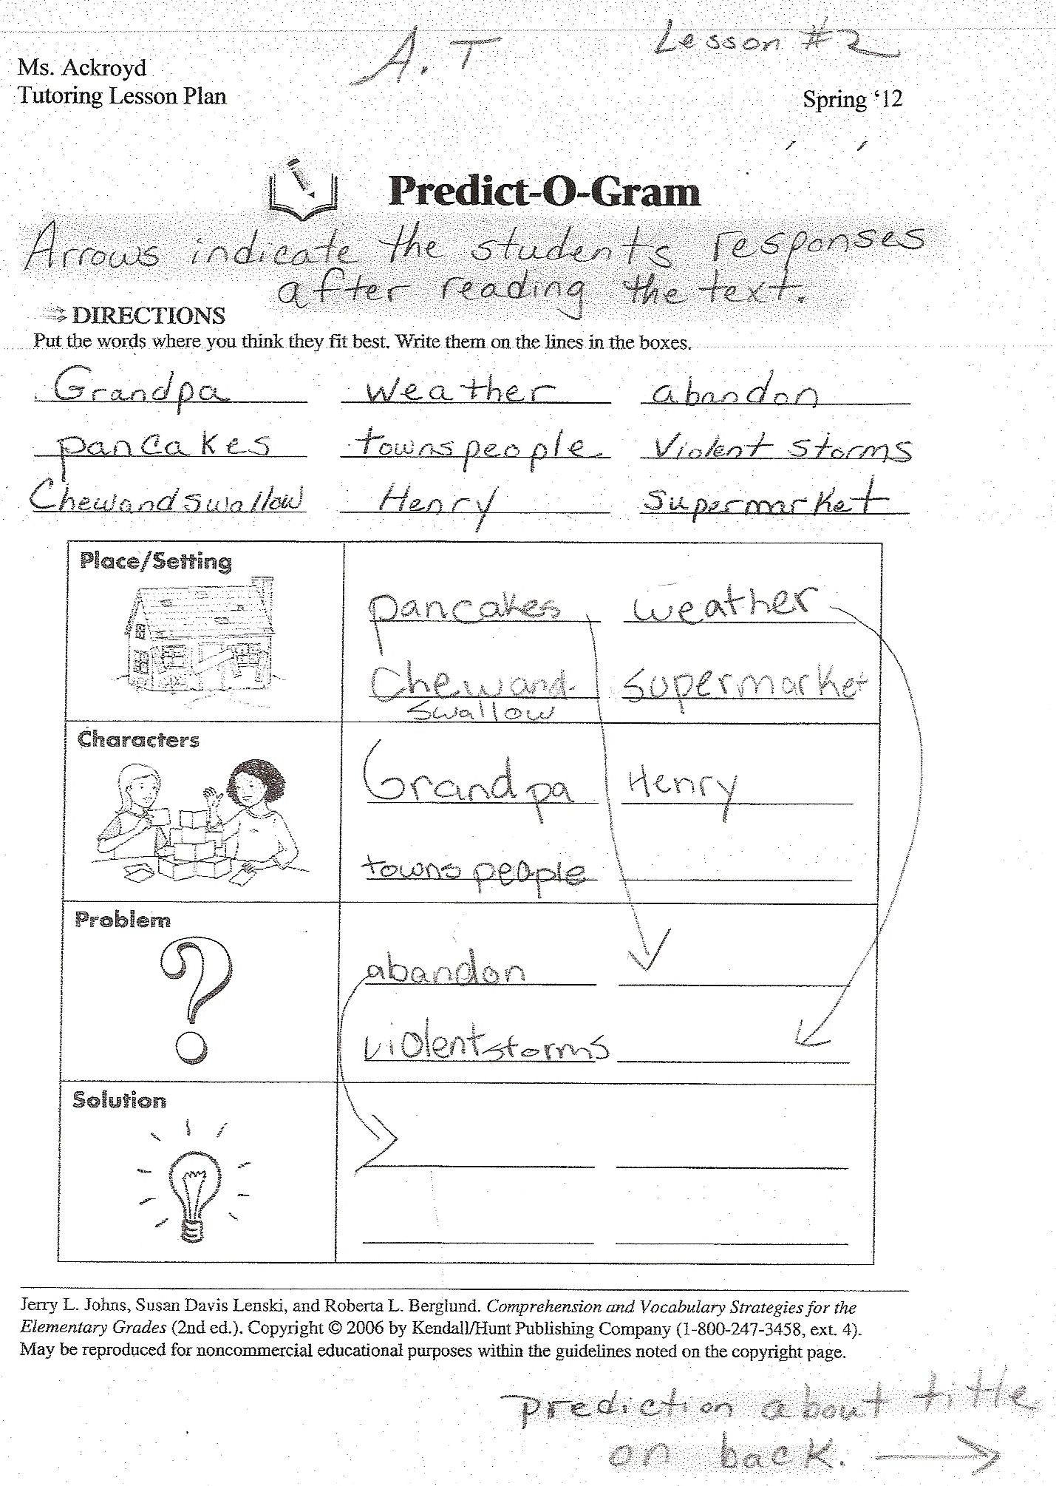
Another example:

Slide 11
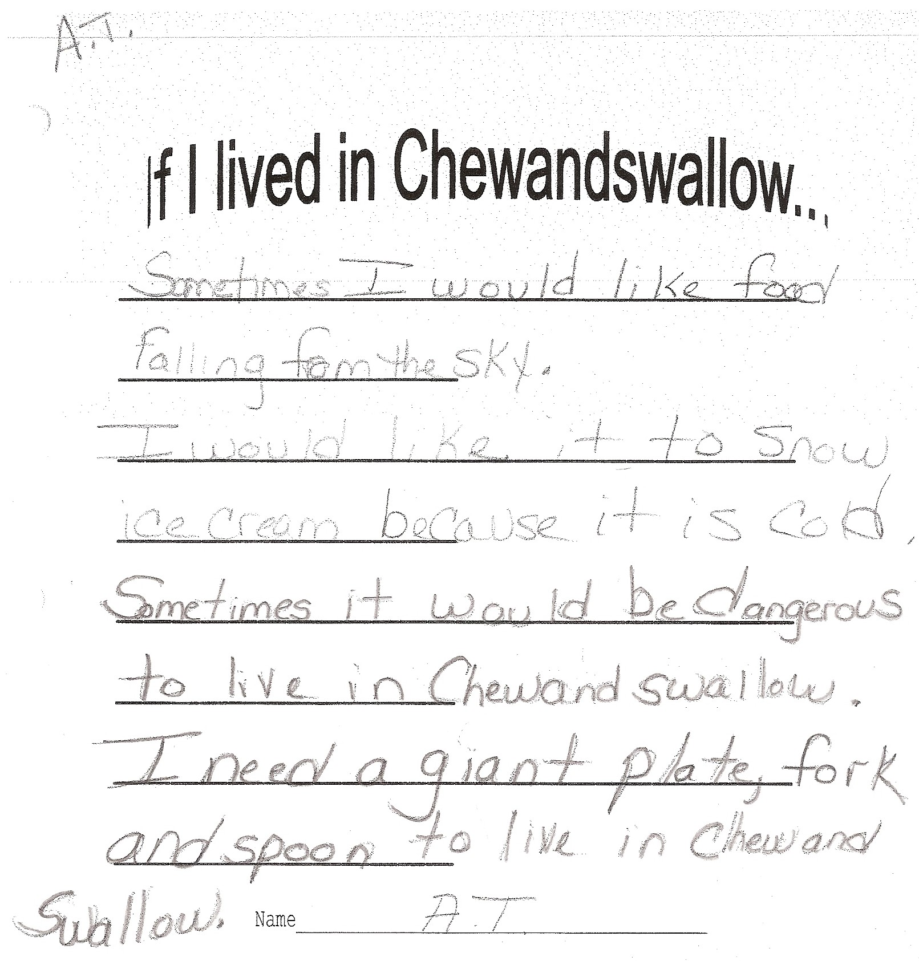

Slide 12
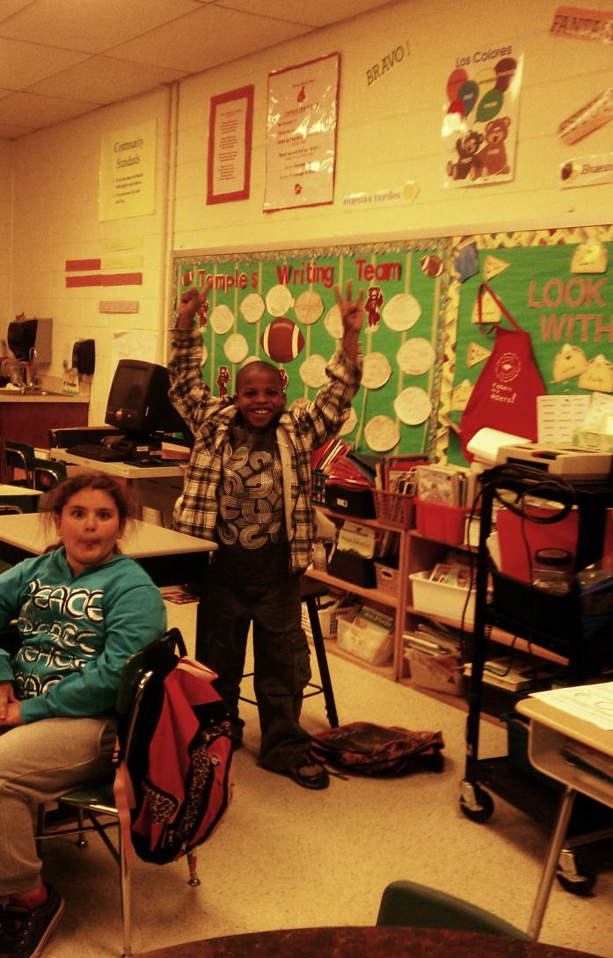
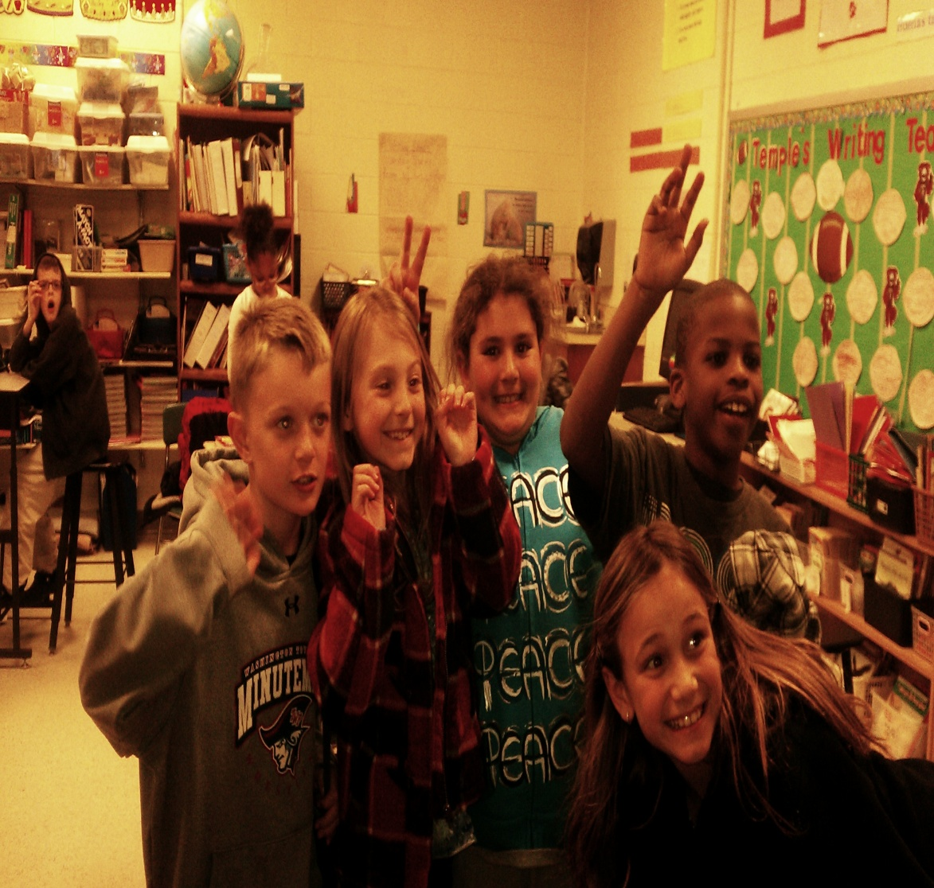
Mr. Cline and Mrs. Wood’s class

